Slide 1
Messy Church® is a registered trade mark of The Bible Reading Fellowship, a Registered Charity (233280)

Slide 2
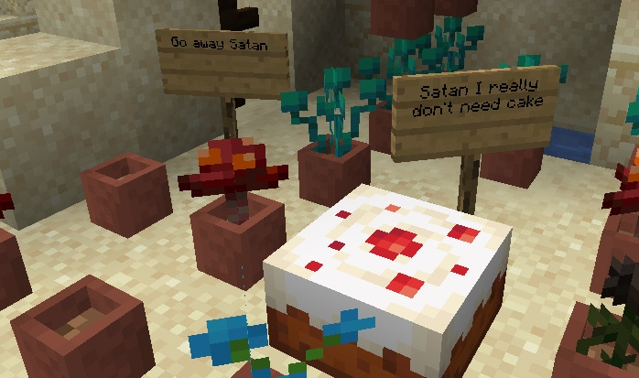
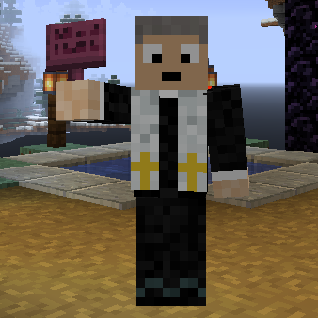
Minecraft in Messy Church
Please take our Poll!

Slide 3
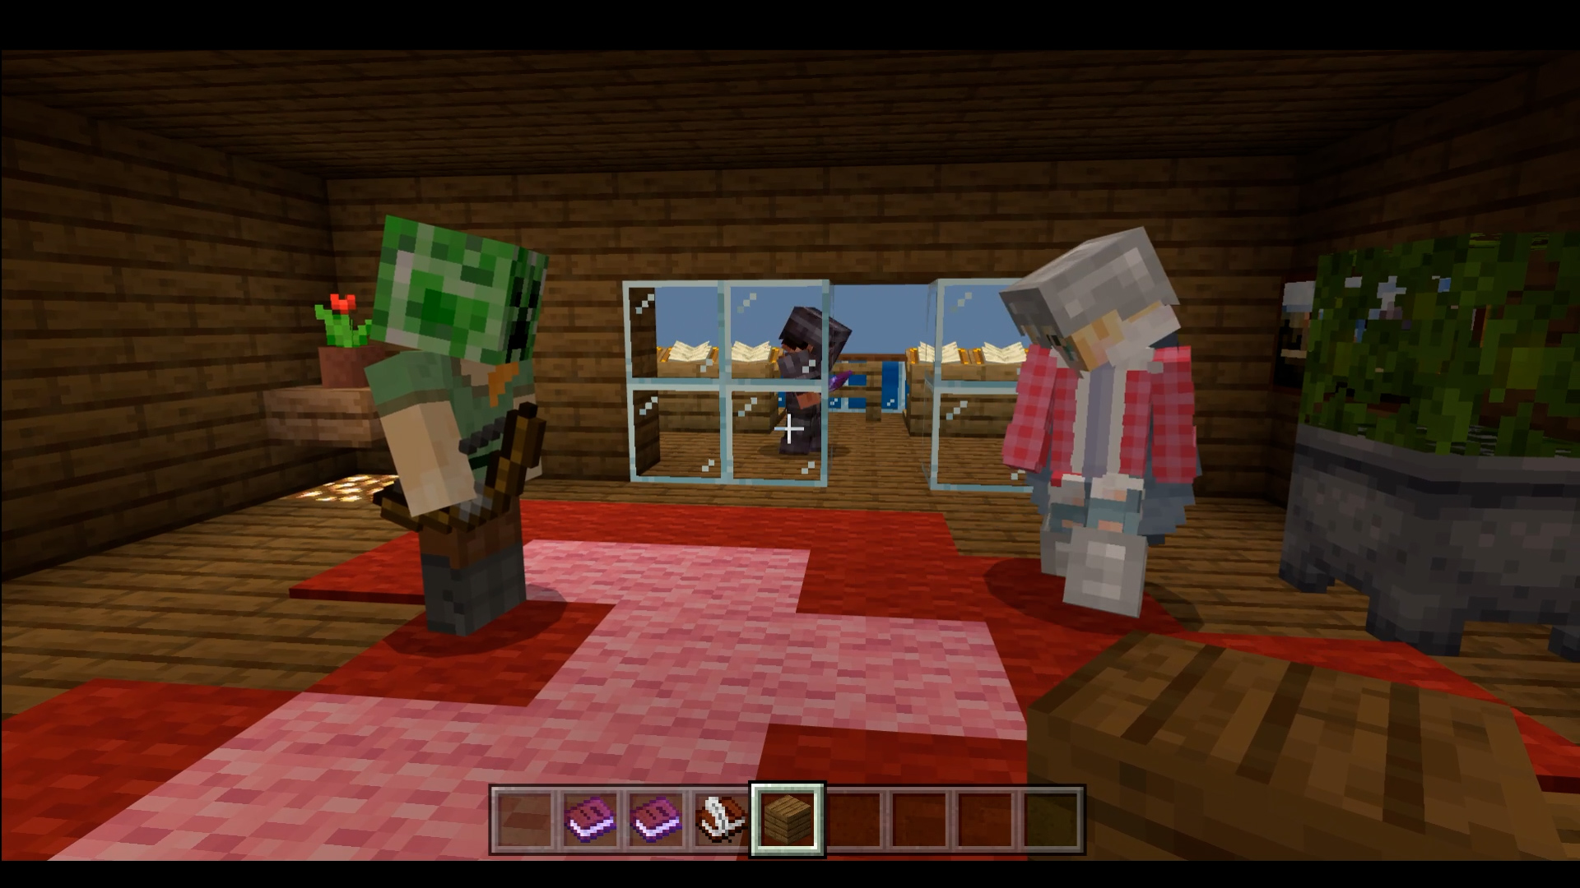
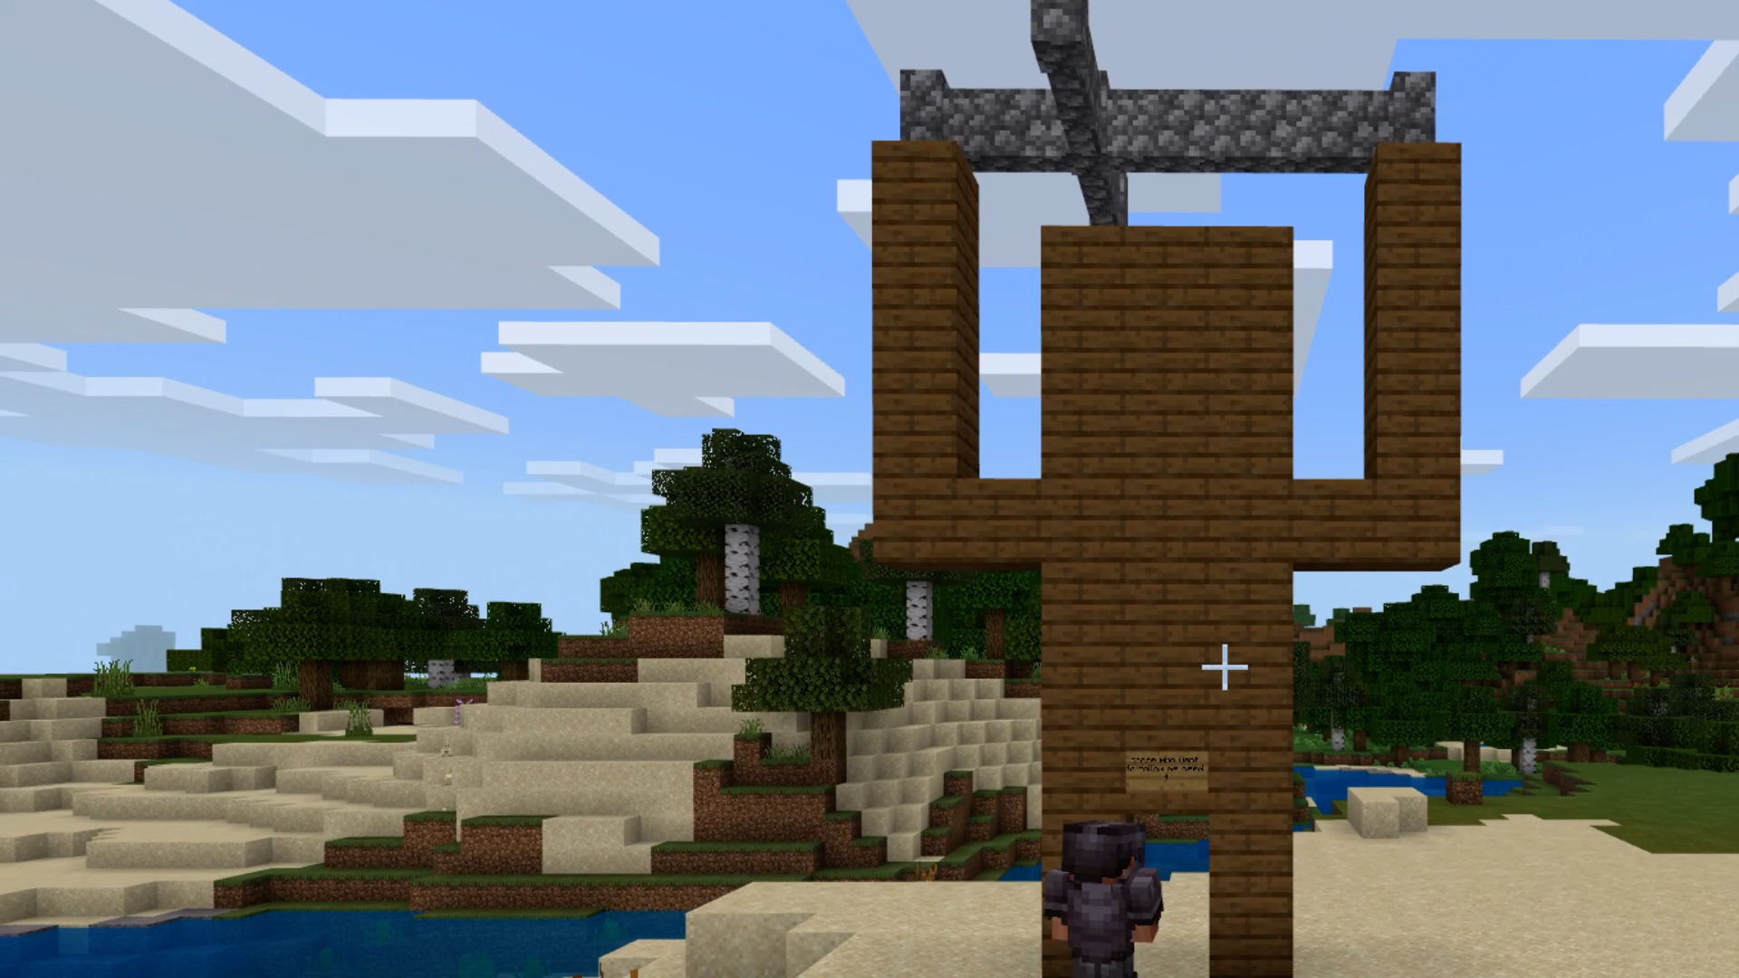
Jo’s Story

Slide 4
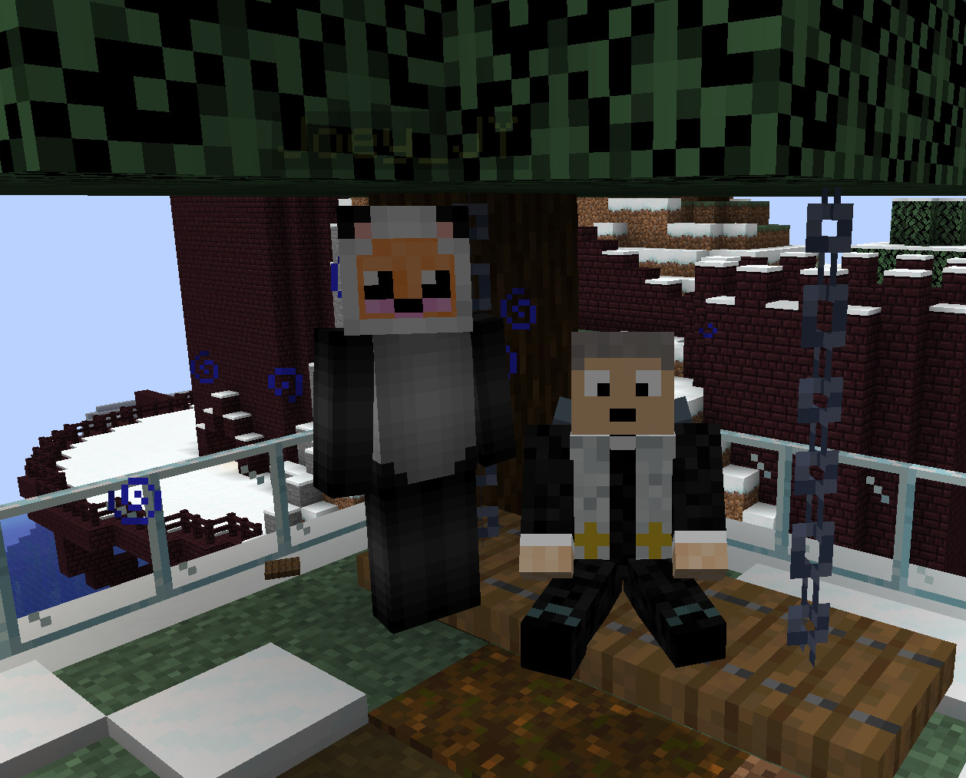
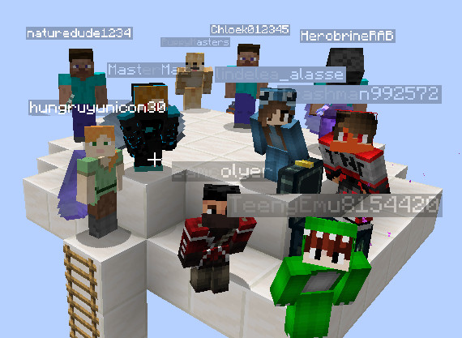
Kev’s story

Slide 5
The Medium of Minecraft
What is possible to do in Minecraft?
What’s not?

Slide 6
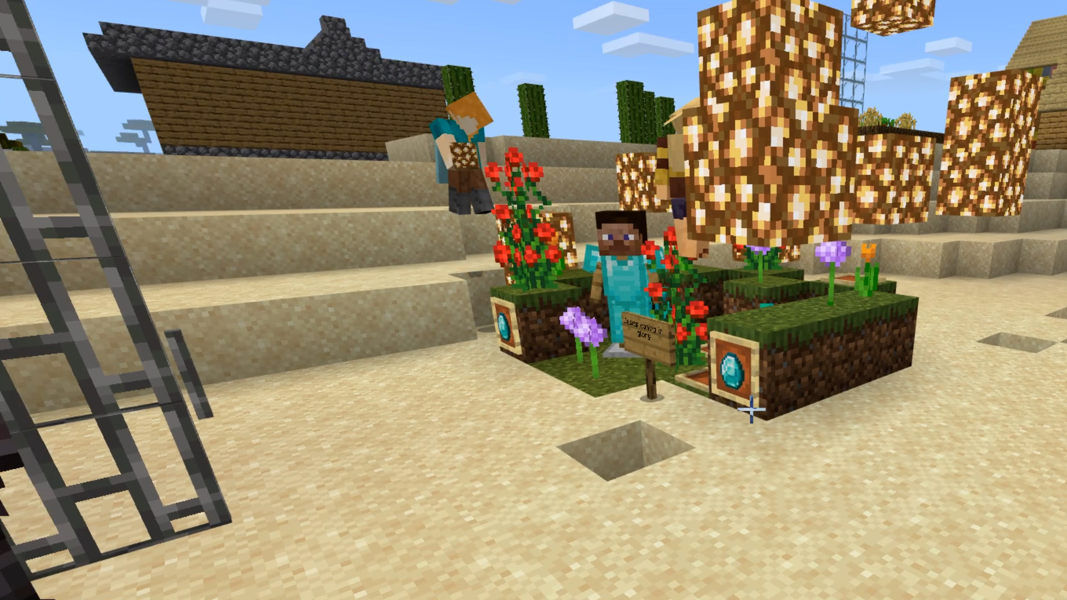
Possibilities
Exploring Bible Stories from the inside
Building, Re-imagining, Enacting
Wondering and Pondering

Slide 7
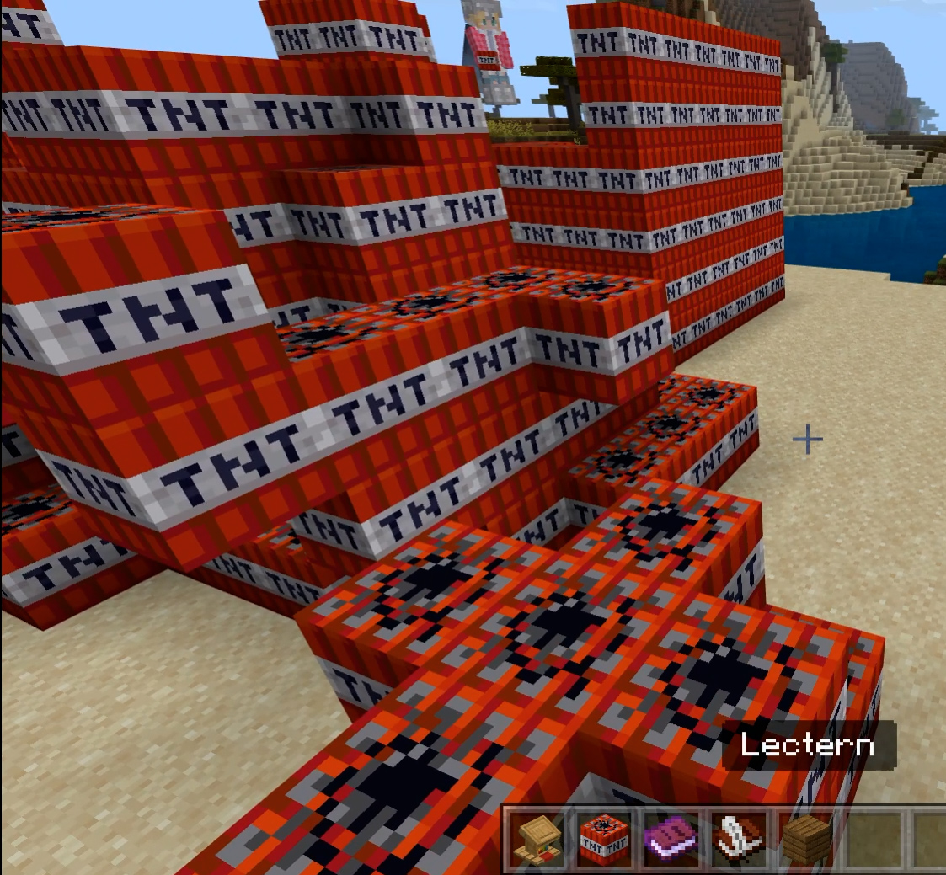
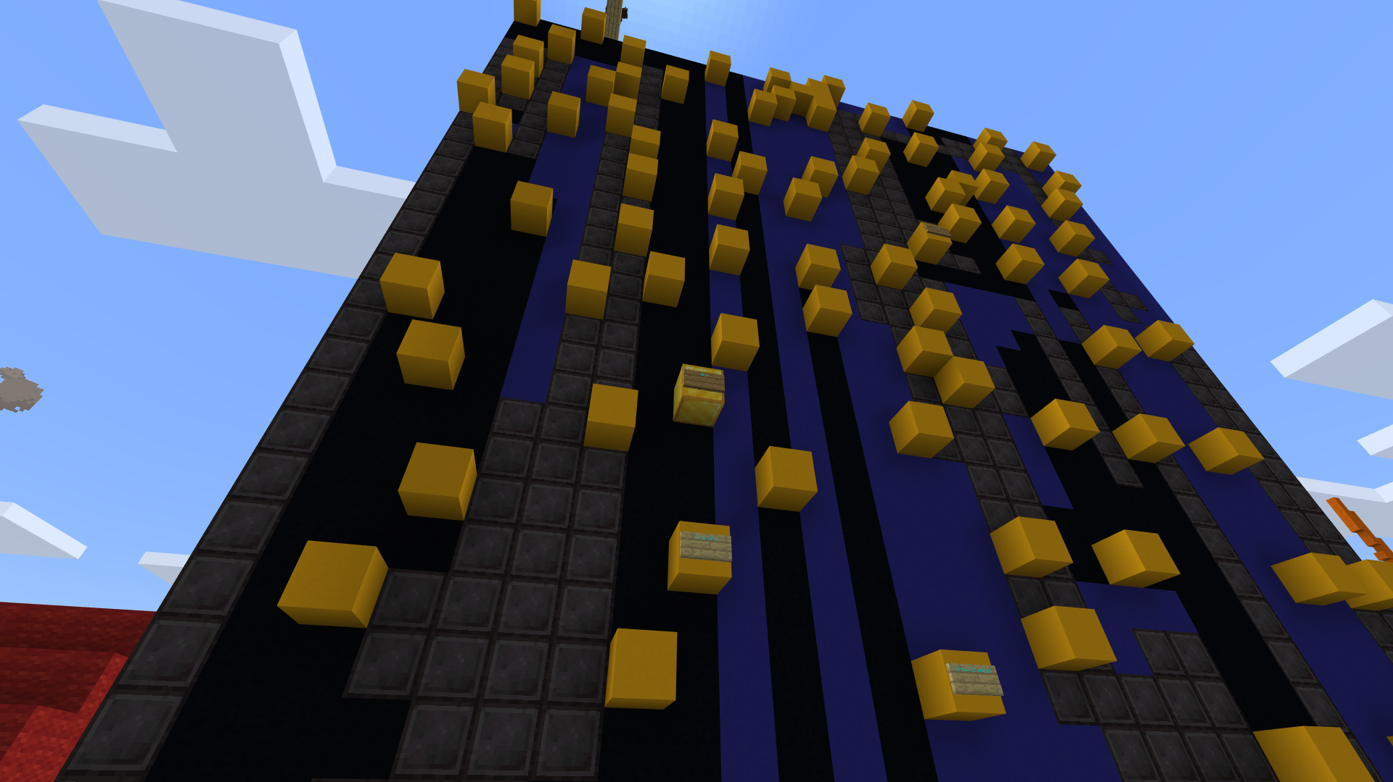
Prayer Station Activities
Thank you flowers
Abraham – Stars wall – praying for people
Confessions with TNT / Void
Dance worship
Anything you use a post-it for can be done with a sign!
Notes:
7

Slide 8
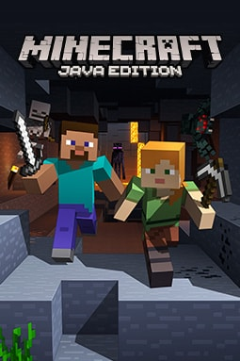
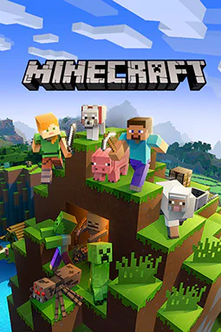
Limitations
Technical burden for leaders
Paid accounts
Bedrock (Tablet, phone and console) VS Java (laptops, PCs)
Connecting and learning how to do multiplayer/ Wrangling with Zoom!
It’s addictive!
Less suited to abstract ideas

Slide 9
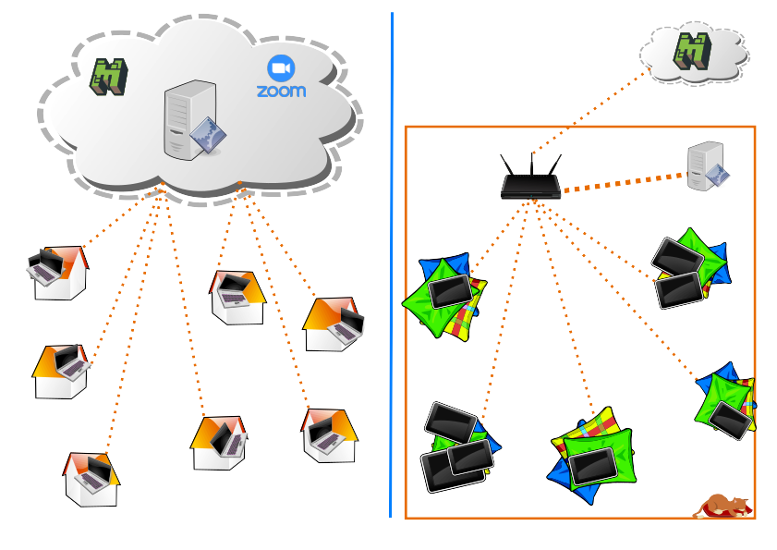
How to use Minecraft in Messy Church 1
Zooming
And
Online
Face to Face and on Cushions

Slide 10
How to use Minecraft in Messy Church 2
As a table activity
Have several tablets/iPads available
Encourage adults to work with children to interpret, explain and reflect back their ideas
Show or use in the act of worship
As an extra
For teenagers, on another evening?
To prepare things for Messy church
As a new venture alongside Messy church (multipying!)
Or… use online gaming to connect to a whole new groups?

Slide 11
Email us!
Rev Kevin Colyer revkevincolyer@gmail.com
Resources: http://www.stmichaelsbray.scalacubes.io/
Rev Jo Jennings revd.jjennings@gmail.com
Jo in action: https://youtu.be/QlTYA16C_hg?t=118

